Slide 1
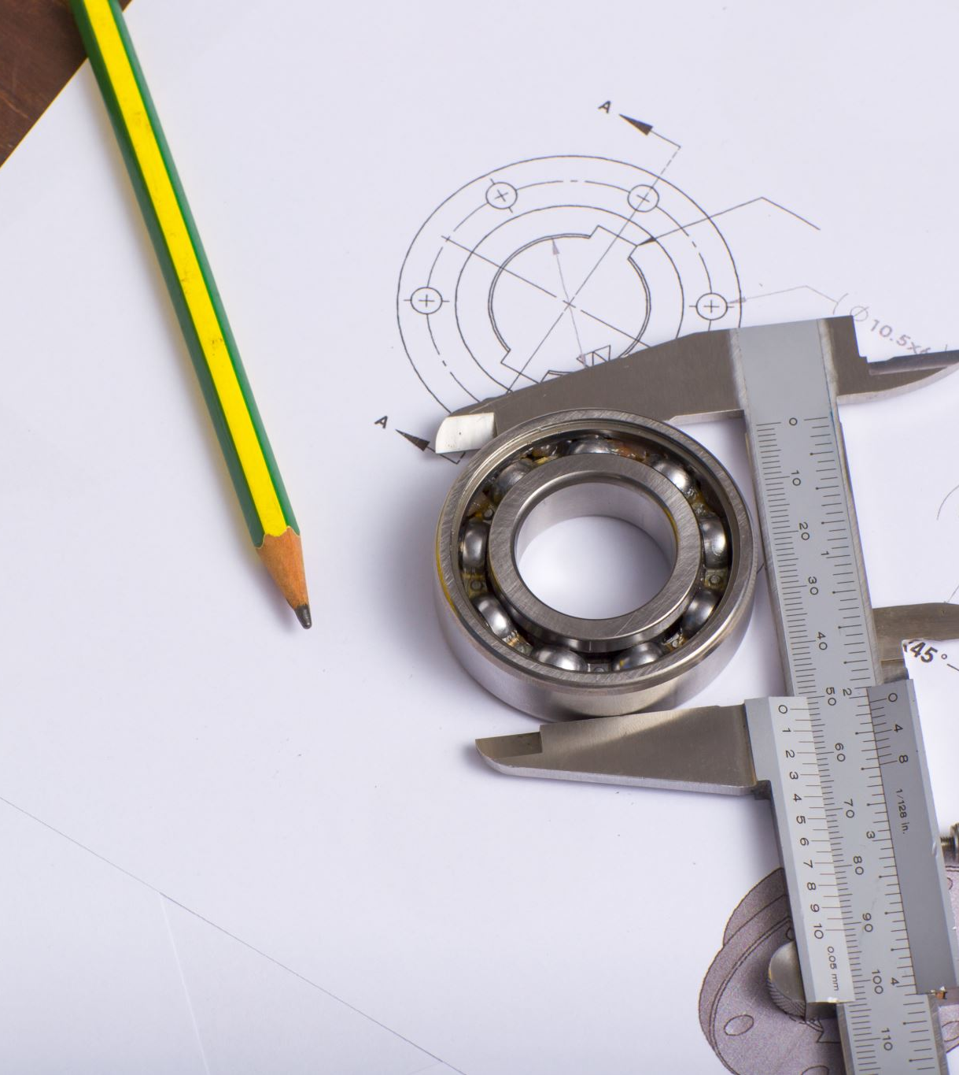

CREATIVE ENGINEERING DESIGN
TECHNICAL METRICS | QFD|IP/OP | SNPS |
PRESENTED BY
TEAM SYNERGY
Rachana
Malavika
Shristi
Ghanshyam
Aniruddha

Slide 2
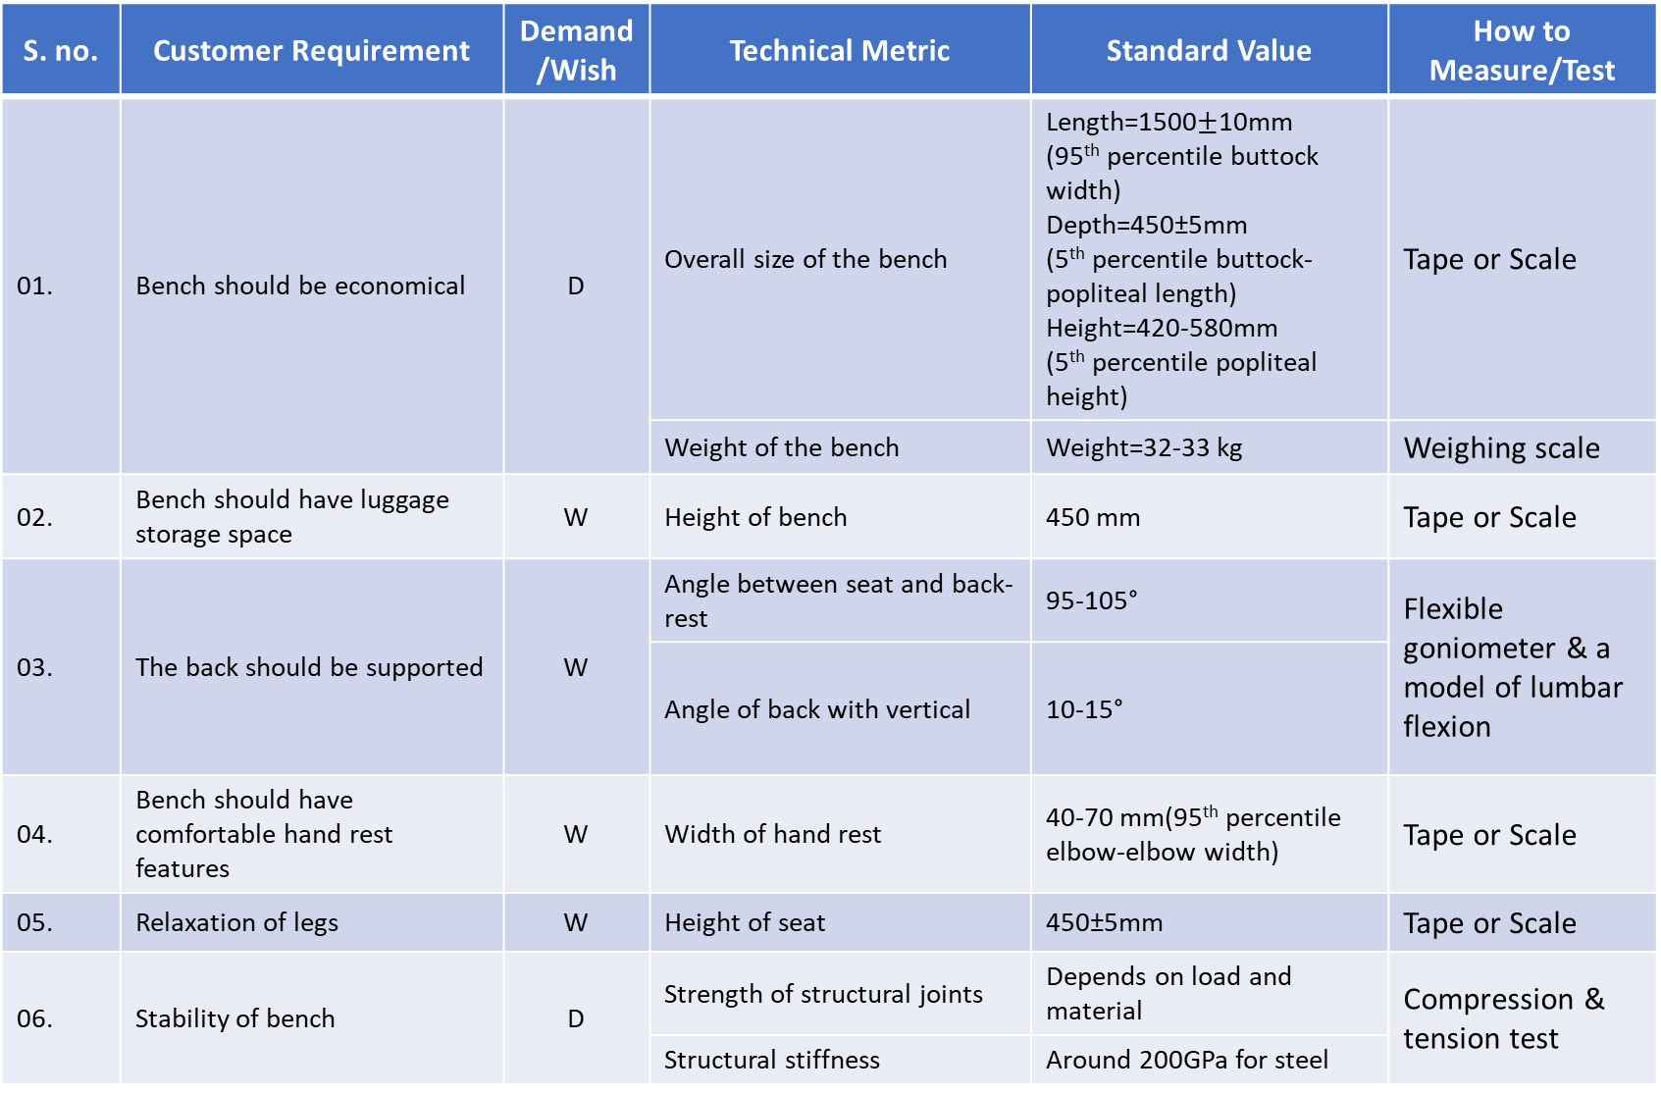
Technical parameters

Slide 3
Technical parameters
S. no. | Customer Requirement | Demand/Wish | Technical Metric | Standard Value | How to Measure/Test
07. | Seats should be able to withstand load | D | Load bearing capacity | 350kg | Static load testing/dynamic load testing
08. | Seats should not have sharp edges | D | Resistance to abrasion of surfaces | - | Taber abraser method, Abrasion Test
09. | Seats should be Easy to clean | W | - | - | -
10. | Seats should be long lasting | D | Resistance of surfaces to corrosion | - | Salt spray test
 |  |  | Strength of bench | - | Unit drop test
Ref.:-
1. https://morth.nic.in/sites/default/files/circulars_document/N_3012405_1637043131682.pdf
(ACCESSIBILITY GUIDELINES FOR BUS TERMINALS AND BUS STOPS)
2. https://www.ijert.org/research/design-considerations-iron-bench-in-the-gardens-IJERTV5IS110235.pdf
3. https://downloads.kimballinternational.com/documents/price-lists/commercial/general-information/ansi-bifma.pdf
4. https://www.micomlab.com/micom-testing/bifma-x6-4/
5. https://cdn.standards.iteh.ai/samples/13772/ee543b33c96948fcb6e4720abb2710cd/ISO-7173-1989.pdf

Slide 4
Matrix for customer requirement priority
Sr. No | Relative Importance Matrix if x > Y then K = 1, if X=Y then K = 0.5 if X<Y then K=0 | K1 | K2 | K3 | K4 | K5 | K6 | K7 | K8 | K9 | K10 | sum | 100 points distribution | 10 points scaling | Rank
1 | Economical |  | 1 | 0.5 | 1 | 1 | 0.5 | 0.5 | 0.5 | 0.5 | 0.5 | 6 | 13.64 | 8.57 | 3
2 | Storage space for luggage | 0 |  | 0 | 0.5 | 0 | 0 | 0 | 0 | 0 | 0 | 0.5 | 1.14 | 0.71 | 7
3 | Back support | 0.5 | 1 |  | 1 | 1 | 0 | 0 | 0 | 0.5 | 0 | 4 | 9.09 | 5.71 | 5
4 | Comfortable hand rest | 0 | 0.5 | 0 |  | 0.5 | 0 | 0 | 0 | 0 | 0 | 1 | 2.27 | 1.43 | 6
5 | Leg relaxation | 0 | 0.5 | 0 | 0.5 |  | 0 | 0 | 0 | 0 | 0 | 1 | 2.27 | 1.43 | 6
6 | stability | 0.5 | 1 | 1 | 1 | 1 |  | 0.5 | 0.5 | 0.5 | 0.5 | 6.5 | 14.77 | 9.29 | 2
7 | Huge load capacity | 0.5 | 1 | 1 | 1 | 1 | 0.5 |  | 0.5 | 1 | 0.5 | 7 | 15.91 | 10.00 | 1
8 | Smooth edges | 0.5 | 1 | 1 | 1 | 1 | 0.5 | 0.5 |  | 0.5 | 0.5 | 6.5 | 14.77 | 9.29 | 2
9 | Easy to clean | 0.5 | 1 | 0.5 | 1 | 1 | 0 | 0 | 0.5 |  | 0 | 4.5 | 10.23 | 6.43 | 4
10 | Durability | 0.5 | 1 | 1 | 1 | 1 | 0.5 | 0.5 | 0.5 | 1 |  | 7 | 15.91 | 10.00 | 1
 |  |  |  |  |  |  |  |  |  |  |  | 44 | 100

Slide 5
INTERRELATIONSHIP BETWEEN TECHNICAL DESCRIPTORS
Sr.No. | Customer Requirements
1 | Durability (5)
2 | Strength (5)
3 | Stability (5)
4 | Smooth edges (5)
5 | Economical (4)
6 | Easy to clean (3)
7 | Back support (3)
8 | Comfortable hand rest (2)
9 | Leg relaxation (2)
10 | Space for luggage (1)
TECHNICAL PARAMETERS
(VOICE OF ORGANIZATION)
RELATONSHIP BETWEEN REQUIRMENTS AND DESCRIPTORS
CUSTOMER REQUIRMENT
(VOICE OF THE CUSTOMER)
PRIORITIZED CUSTOMER (COMPETITIVE AND BENCHMARKING ANALYSIS)
PRIORITIZED TECHNICAL DESCRIPTORS

Slide 6
INTERRELATIONSHIP BETWEEN TECHNICAL DESCRIPTORS
TECHNICAL PARAMETERS
(VOICE OF ORGANIZATION)
RELATONSHIP BETWEEN REQUIRMENTS AND DESCRIPTORS
CUSTOMER REQUIRMENT
(VOICE OF THE CUSTOMER)
PRIORITIZED CUSTOMER (COMPETITIVE AND BENCHMARKING ANALYSIS)
PRIORITIZED TECHNICAL DESCRIPTORS

Slide 7
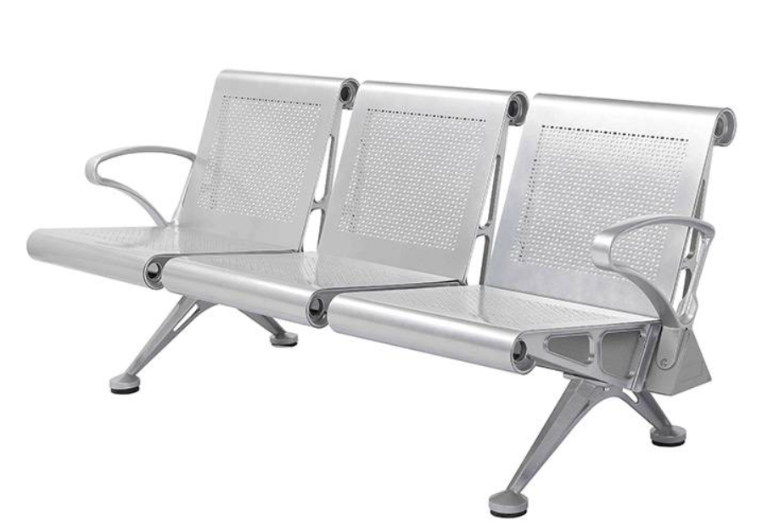
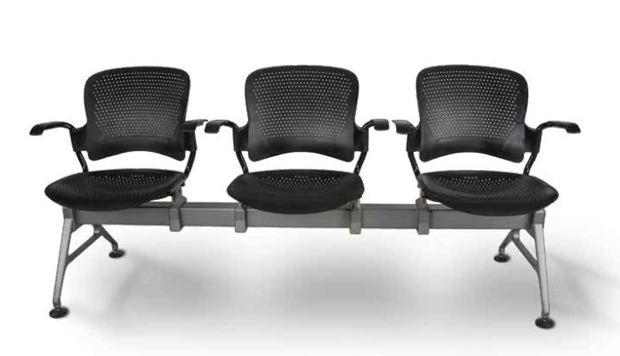
Competitive product evaluation
MANUFACTURER- SYONA
Price: 18800 RS
MANUFACTURER- EKINTOP Price: 8889 RS
ROOTS - SYONA GANG SERIES - Trifold_2022_V03A.pdf
Gang Venus Waiting Chair Series - Syona Roots
Cheap airport chair manufacturers, Office furniture solutions | Ekintop (kintopfurniture.com)
REF:

Slide 8
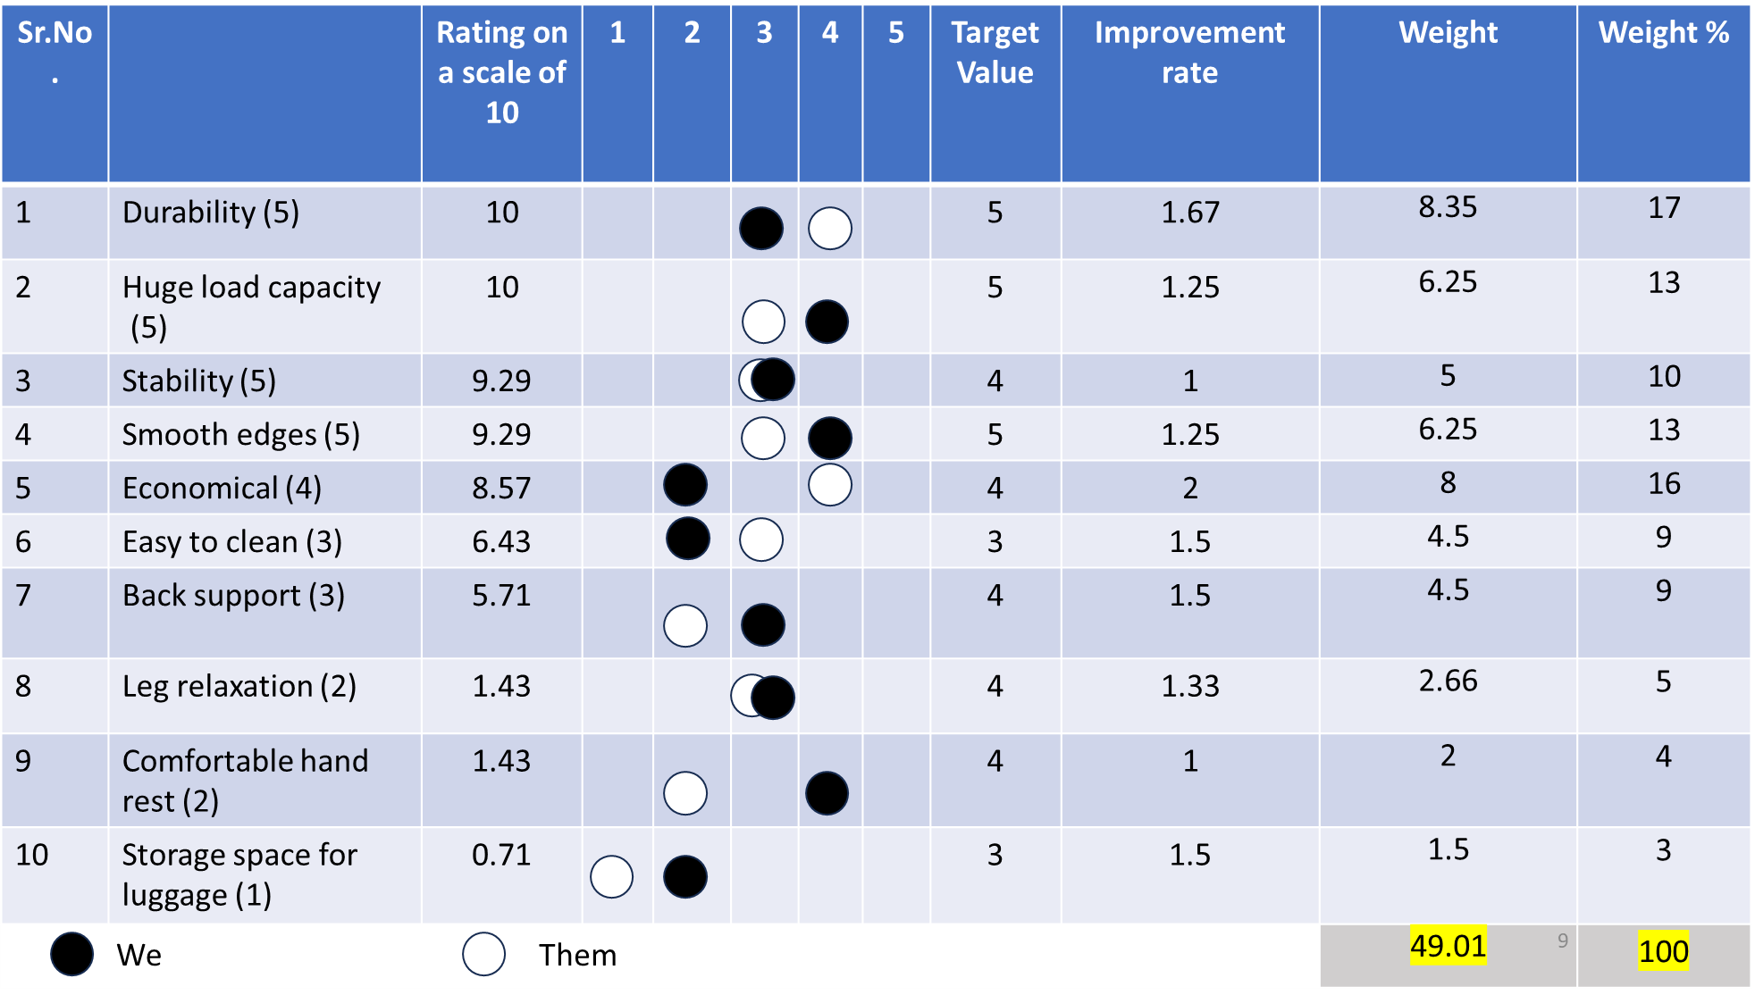
Competitive product evaluation
Product 1
Product 2

Slide 9
INTERRELATIONSHIP BETWEEN TECHNICAL DESCRIPTORS
TECHNICAL PARAMETERS
(VOICE OF ORGANIZATION)
RELATONSHIP BETWEEN REQUIRMENTS AND DESCRIPTORS
CUSTOMER REQUIRMENT
(VOICE OF THE CUSTOMER)
PRIORITIZED CUSTOMER (COMPETITIVE AND BENCHMARKING ANALYSIS)
PRIORITIZED TECHNICAL DESCRIPTORS

Slide 10
Technical requirement and metrics
Customer Requirement | Technical metric
economical | Length, Depth, Height, Weight of the bench
Storage space for luggage | Height of bench
Back support | Angle between bench and back, Angle of back-rest from vertical
Comfortable hand rest | Width of hand rest
Leg relaxation | Height of seat
Bench stability | Strength of structural joints, Structural stiffness
Huge load capacity | Load bearing capacity
Smooth edges | Resistance to abrasion of surfaces
Easy to clean | Resistance of surfaces to corrosion
Durability | Resistance of surfaces to corrosion, strength

Slide 11
INTERRELATIONSHIP BETWEEN TECHNICAL DESCRIPTORS
TECHNICAL PARAMETERS
(VOICE OF ORGANIZATION)
RELATONSHIP BETWEEN REQUIRMENTS AND DESCRIPTORS
CUSTOMER REQUIRMENT
(VOICE OF THE CUSTOMER)
PRIORITIZED CUSTOMER (COMPETITIVE AND BENCHMARKING ANALYSIS)
PRIORITIZED TECHNICAL DESCRIPTORS

Slide 12
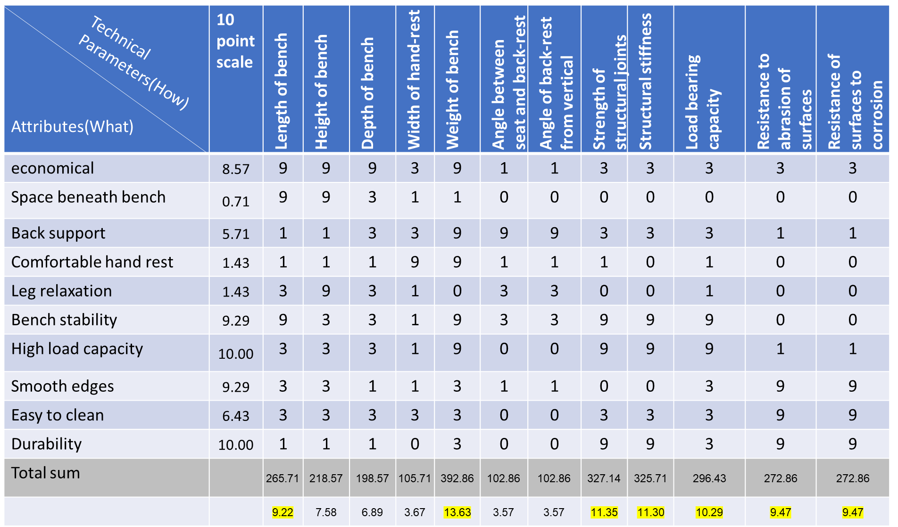
Interaction matrix
Technical Parameters(How)
Attributes(What)

Slide 13
INTERRELATIONSHIP BETWEEN TECHNICAL DESCRIPTORS
TECHNICAL DESCRIPTORS
(VOICE OF ORGANIZATION)
RELATONSHIP BETWEEN REQUIRMENTS AND DESCRIPTORS
CUSTOMER REQUIRMENT
(VOICE OF THE CUSTOMER)
PRIORITIZED CUSTOMER (COMPETITIVE AND BENCHMARKING ANALYSIS)
PRIORITIZED TECHNICAL DESCRIPTORS

Slide 14
:Strong Negative Relation
:Negative Relation
:Positive Relation
: Strong Positive Relation
1 | 2 | 3 | 4 | 5 | 6 | 7 | 8 | 9 | 10 | 11 | 12
length of bench | height of bench | depth of bench | width of hand rest | weight | angle b/w seat & back rest | angle of back rest from vertical | strength of structural joint | structural stiffness | Load bearing capacity | resistance to abrasion of surfaces | resistance of surface to corrosion
Notes:
The relationship between the height and length of a bench is not inherently positive or negative; it depends on the specific design and purpose of the bench. Whether the relationship is positive, negative, or neutral (no correlation) will depend on the design choices and ergonomic considerations made by the bench designer.
In some cases, a positive relationship may be desired, where an increase in height corresponds to an increase in length. For example, a taller bench with a longer seat may be designed to provide more seating space or accommodate taller individuals comfortably.
In other cases, a negative or inverse relationship may be preferred, where an increase in height corresponds to a decrease in length. For example, a high-backed bench may have a shorter seat to create a more upright and formal seating posture.
Ultimately, the relationship between the height and length of a bench is a design choice, and it can vary based on the specific needs, aesthetics, and functionality of the bench in question. There is no fixed or universal rule regarding whether the relationship should be positive or negative.

Slide 15
INTERRELATIONSHIP BETWEEN TECHNICAL DESCRIPTORS
TECHNICAL DESCRIPTORS
(VOICE OF ORGANIZATION)
RELATONSHIP BETWEEN REQUIRMENTS AND DESCRIPTORS
CUSTOMER REQUIRMENT
(VOICE OF THE CUSTOMER)
PRIORITIZED CUSTOMER (COMPETITIVE AND BENCHMARKING ANALYSIS)
PRIORITIZED TECHNICAL DESCRIPTORS

Slide 16
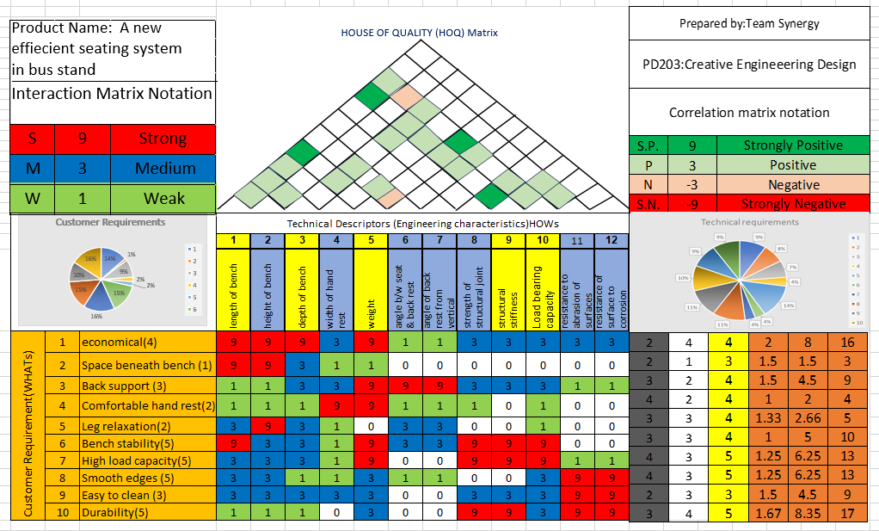

Slide 17
Metric and Competitive Benchmarking
Metrics | Unit | Product 1 | Product 2 | Target
Length of bench | mm | 1890 | 1800 | 1850
Height of bench | mm | 462 | 540 | 500
Depth of bench | mm | 610 | 640 | 650
Width of hand-rest | mm | 50 | 40 | 50
weight | Kgf | 30 | 27 | 30
Angle between seat and back-rest | degree | 105 | 110 | 110
Angle of back-rest from vertical | degree | 15.5 | 17.45 | 17.45
Strength of structural joints | N
Structural stiffness | GPa |  |  | 200 GPa
Ability to withstand load | Kgf | 375 | 325-350 | 400
Resistance to abrasion of surfaces
Resistance of surfaces to corrosion

Slide 18
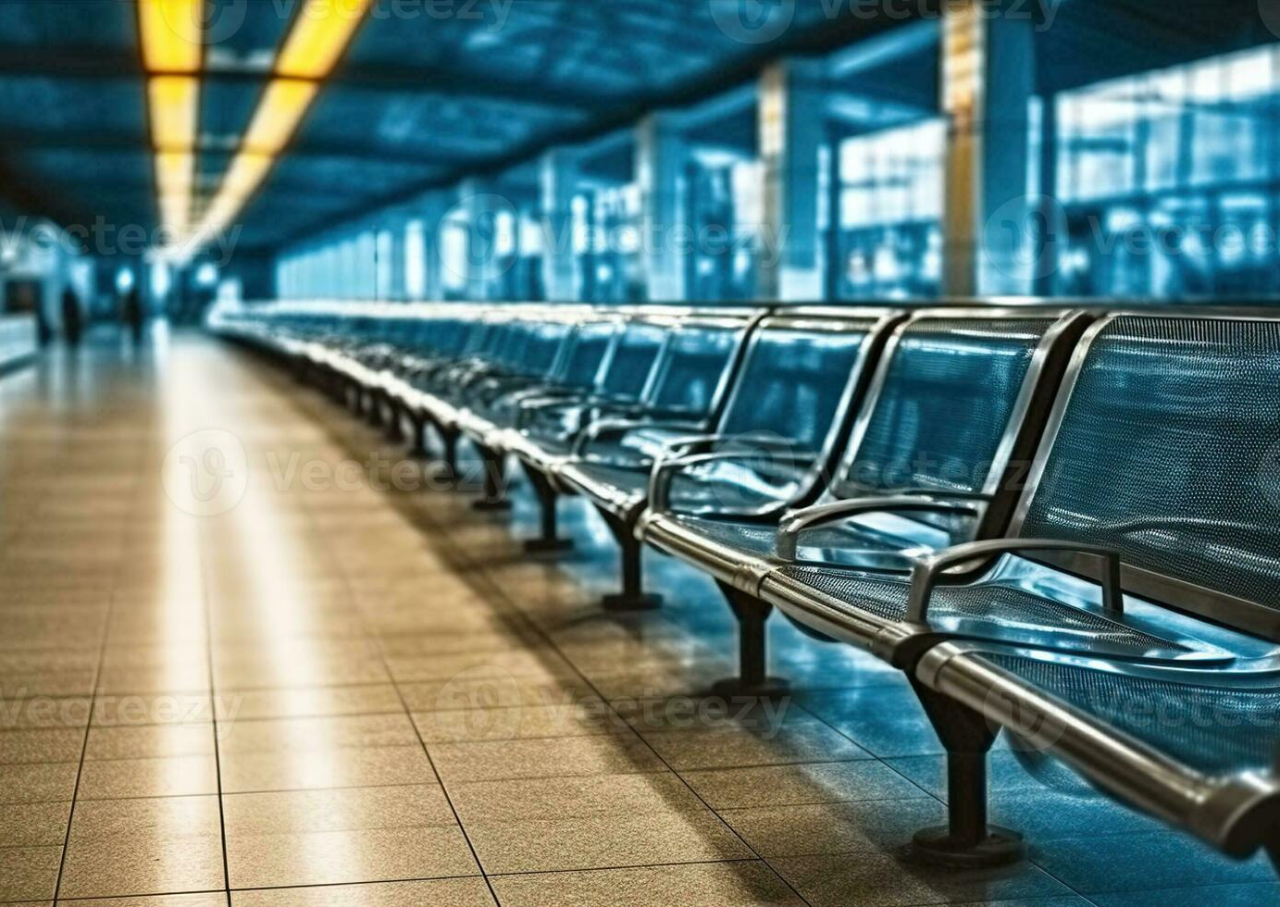
SNPS
realistic
To find an economical seating arrangement which should provide comfort, is easy to maintain and provide resistance towards vandalism in the bus stand & promote crowd mobility.
unrealistic
To find a natural seating arrangement which provide comfort, requires zero maintenance cost & is immune to any form of vandalism in the bus stand.

Slide 19
Input Output Description
OUTPUT STATE
INPUT STATE
Passenger (standing while waiting for bus)
Uncomfortable
Impatience leading to frustration
Inconvenience (say, with luggage)
Health concern (e.g., joint pain)
Bus stand
Crowd overflow
Difficult to clean
Safety Issue (probability of accident)
Passenger (sitting while waiting for bus)
Comfortable
Better waiting experience
Safety improves as flow of crowd is enhanced
Easier to clean
Economical
Transformation medium:
Sitting
Organized arrangement
Do not hinder mobility of crowd
Anti vandalism feature
Low maintenance

Slide 20

Thank you

